Slide 1

Dr.seq2
Quick Start
——A case using for Drop-seq datasets

Slide 2
Introduction
Dr.seq2 is a QC and analysis pipeline for parallel single cell transcriptome and epigenome data.
Dr.seq2 provides QC and analysis for three major data types:
  single cell transcriptome data (DrSeq part)
  Drop-ChIP data (DrChIP part)
  scATAC-seq data (ATAC part)

Slide 3
STEP0.input
drseq_test_1.fastq
drseq_test_2.fastq
Barcode
Reads
Cell barcode
UMI
NNNN…NNNNN
AAAAAAAAAAAACCCCCCCCN…N

Slide 4


STEP1.Install environment
or
python(version = 2.7)
and
R(version >= 2.14.1)

Slide 5
STEP2.Download
Download:
$ wget https://zhanglab.tongji.edu.cn/softwares/Drseq2/download/Dr.seq2.1.2.zip
$ unzip Dr.seq2.1.2.zip
$ cd Dr.seq2.1.2
Or:
$ git clone https://github.com/ChengchenZhao/DrSeq2.git
$ cd DrSeq2

Slide 6
STEP3.Install
For root users:
$ sudo python setup.py install
For other users:
$ python setup.py install --prefix /home/DrSeq2
# here you can replace "/home/DrSeq2" with any location you want
$ export PATH=/home/DrSeq2/bin:$PATH
# setup PATH, so that system knows where to find executable files
$ export PYTHONPATH=/home/DrSeq2/lib/python2.7/site-packages:$PYTHONPATH
# setup PYTHONPATH, so that Dr.seq2 knows where to import modules
Test:
$ DrSeq -h

Slide 7
STEP4.Prepare mapping software & index
bowtie2
mm9.1.bt2
mm9.2.bt2
…
https://sourceforge.net/projects/bowtie-bio/files/bowtie2/
hisat2
mm9.1.ht2
mm9.2.ht2
…
http://ccb.jhu.edu/software/hisat2/index.shtml
SA
Saindex
…
STAR
https://github.com/alexdobin/STAR/archive/master.zip

Slide 8
STEP4-1.Install Bowtie2
For root users:
$ unzip bowtie2-2.2.6-linux-x86_64.zip # bowtie2-2.2.6-macos-x86_64.zip for macOS
$ cd bowtie2-2.2.6-linux-x86_64 # bowtie2-2.2.6-macos-x86_64 for macOS
$ sudo cp bowtie2* /usr/local/bin # don’t forget to type * mark here
$ echo $PATH #to check the list of your default PATH
For other users:
$ unzip bowtie2-2.2.6-linux-x86_64.zip # bowtie2-2.2.6-macos-x86_64.zip for macOS
$ cd bowtie2-2.2.6-linux-x86_64 # bowtie2-2.2.6-macos-x86_64 for macOS
$ sudo cp bowtie2* /home/DrSeq2/bin # don’t forget to type * mark here

Slide 9
STEP4-2.Build bowtie2 index
Built bowtie2 index files:
$ bowtie2-build mm9.fa /home/user/bowtie2_index/mm9
Bowtie2 index for the species of our datasets
mm9.1.bt2
mm9.2.bt2
mm9.3.bt2
mm9.4.bt2
mm9.rev.bt2
mm9.rev.bt2

Slide 10
STEP5.Prepare gene annotation
Gene annotation information for the species of our datasets
mm9_refgenes.txt
bin | name | chrom | strand | txStart | txEnd | cdsStart | cdsEnd | exonCount | exonStarts | exonEnds | score | name2 | cdsStartStat | cdsEndStat | exonFrames
0 | NM_001282945 | chr1 | - | 134199214 | 134235457 | 134202950 | 134234355 | 3 | 134199214,134234014,134235227, | 134203590,134234446,134235457, | 0 | Adora1 | cmpl | cmpl | 2,0,-1,
http://genome.ucsc.edu/cgi-bin/hgTables

Slide 11
STEP6. Generate a config file
Generate a template of config file:
$ DrSeq gen -n my_config.conf
[General]
[Step1_Mapping]
[Step2_ExpMat]
[Step3_QC]
[Step4_Analysis]
[General]
[Step1_Mapping]

Slide 12
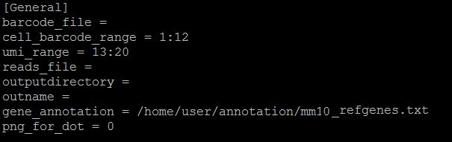
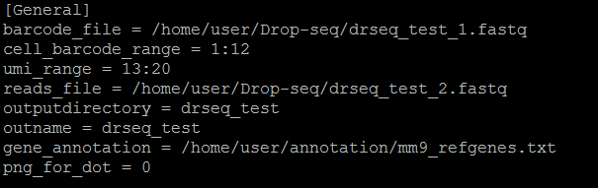
STEP7. Change parameters
[General]
!
!
!
!
!

Slide 13
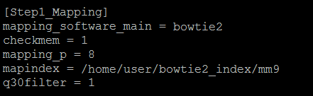
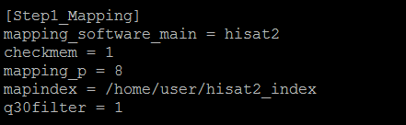
STEP7. Change parameters
[Step1_Mapping]
!
!

Slide 14
STEP8.Run DrSeq with a config file
Run DrSeq with a config file :
$ DrSeq run -c my_config.conf
It will run for a while, depending on the size of your datasets and the performance of your server.
Put it in the background to run:
$ nohup DrSeq run -c my_config.conf >log&

Slide 15
STEP9.Result files
summary
mapping
annotation
expmatrix
QC
analysis
my_config.conf
progress_log.txt
Plots
Results
drseq_test_summary.pdf
drseq_test
drseq_test.sam
drseq_test_expmat.txt
drseq_test_qcmatfull.txt
drseq_test_qcmat.txt
drseq_test_cluster.txt

Slide 16
STEP10.FAQs
If you only have a sam file:
Sam file
Change config file
reads_file = drseq_test.sam
If you have a matrix file:
expmat.txt
Use comCluster
Adjust parameters
If no PDF in your results:
No PDF
pdflatex
$ pdflatex drseq_test_summary.tex

